Slide 1
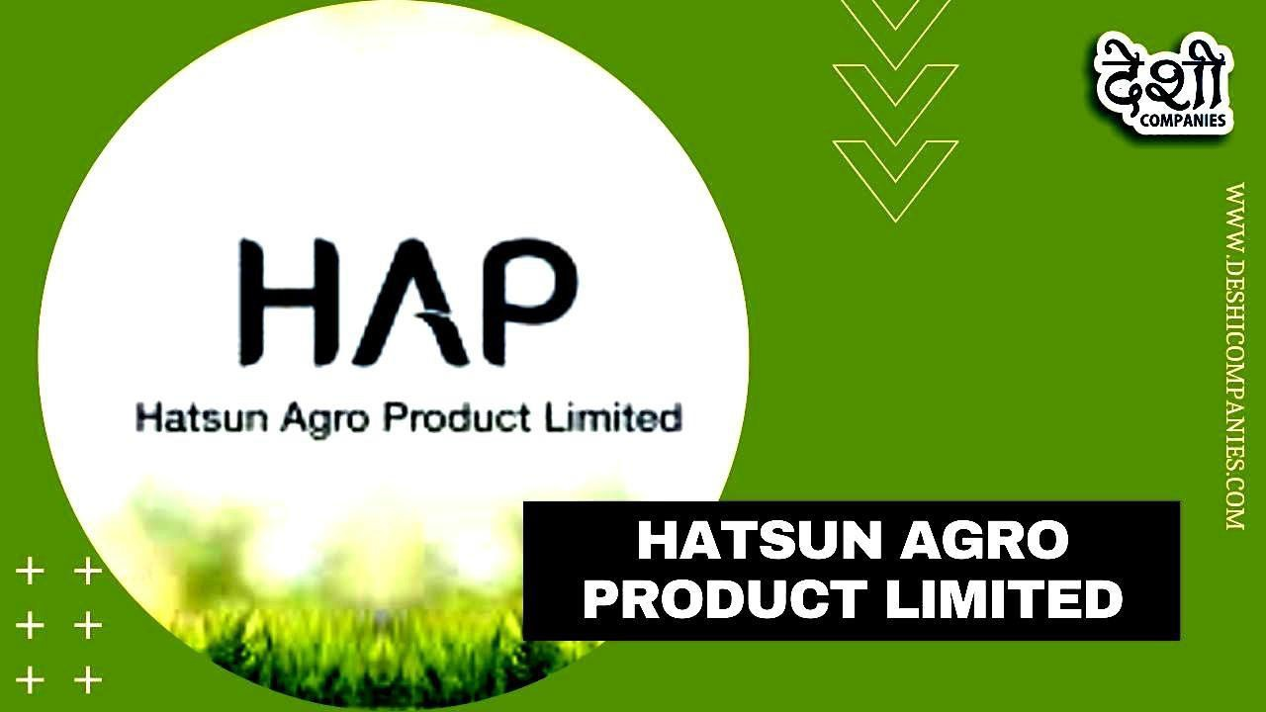










Slide 2
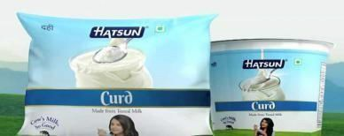
Hatsun Agro Product
1: Brand study, Competitor Analysis & Part Buyer’s/Audience’s Persona
Research Brand:
Mission/values: To satisfy the and nutritional requirement for the custumer of the word through excellence the markecting committed to offer quality product that provisdes best value for more. Give customers a good, faire deal. Great customer relationship take time.
USP: The main USP of the hatsun agro products brand is its low pricing. It hits the transnationals by reducing the prices on its products portfolio.
Analyze Brand tone an Identity:hatsun agro products brand identity is centred around the the iconic hatsun agro products curd packect has manfacturing wuth pure cow milk and it becomes synonymous with brands.

Slide 3
Brand Study (Missin/Value & USP)
Mission&values:Simple hatsun agro products mission is to provide hatsun product solutions that are clean, kind, and effective. There values include:
Clean: stream is an integral part of any processing or manufacturing industry.
Food,Pharma, Chemicals,Power, Steel, Tyre and petrochemical, wherever we go, steam is an important energy career for processing the final and finished goods.
Kind: Arun Icecream, Arokya Milk, HatsunCurd, Hatsun Paneer, Hatsun Ghee, Hatsun Dairy Whitener and Ibaco have become popular choices across the country.
Effective: Hatsun agro products are packed with packets and published with social media
and delivery throught the food products. The hatsun agro product was in various ways like
ice cream, hatsun curd etc…
Unique Selling Proposition (USP) Swot Analysis:
SWOT Analyasis is a proven management framework which enables a brand like Hatsun Agro to benchmark its business & performance as compared to the competitors. Hatsun Agro is one of the leading brands in the food & beverages sectors.
The list of hatsun Agro Products SWOT (Strength, Weakness, opportunities, Threats),top Hatsun Agro competitors and includes its target market, segmentation, positioning & Unique Selling Proposition(USP).

Slide 4
Brand study(Brand Tone & KPI)
Brand Tone
Our brands have become household names in over one Indian houses. Arun ice cream, Arokyamilk, Hatsuncurd, Paneer, Hatsunghee, hatsunDairy whitener and ibco have become poppular across the country.
Our brands enjoy considerable share in the states of Tamil Nadu, Andhra Pradesh, Telangana, Karnataka, Puducherry, Kerala, Maharashtra, Goa, Gujarat, Chhattisgarh and
Odisha. This is made possible by the overwhelming feedback from our consumers about the quality of our products. As always, we are grateful for their appreciation, and will continue
to develop our products aided by our prolific Research & Development team.
Hatsun Agro product KPIs includes Simple:
Salesgrowth: Hatsun Agro Product, a leading dairy products company, announced their financial results for the second quarter opf fiscal year 2024 on 19th October, 2023. the company reported a 9.02% year-on-year increase in revenue and a remarkable 82.6% year-on-year growth in profit.
Customer Satisfaction: tracking customer feedback and reviews to ensure that products meet customer expectations and address their hatsun Agro Products his needs.
Brand awareness: Monitoring te brand’s visibility and recognition in the market, indicating the success of marketing and adverting efforts.
Market Share: Comparing the simple Hatsun Agro Products sales and market presence to indicating the brands position Agro products in industry is days range is 988.55-
10112.05 like increaseing market share.
Hatsun Agro Product Ltd is in the FMCG sector, having a market capitalization of Rs.
22215.8 crore. It has reported a sales of Rs. 1887.49 crores and a net profit of Rs. 57.4 cores for the quarter ended December 2018.
The company management includes R G Chandramogan, R G Chandramogan,C
Sathyan,K S Thanarajan,P Vaidyanathan,V R Muthu,Balasubramanian Thenamuthan, TBalaji,S Subramanian,Chalini Madhivanan,D Sathyanarayan,V R Muthu (Hatsun Agro Product Ltd) among others.
The current share price of Hatsun Agro Product is Rs 995.95.
One can use valuation calculators of ticker to know if Hatsun Agro Product share price is undervalued or overvalued.

Slide 5
Buyer/Audience Persona
Name: Hatsun Agro Product Name: Tarak
Age: 24
Gender: Male Occupation: Teacher Incone: 4-5LPA
Goals:
Hatsun Agro Product Ltd. has been committed to enriching the lives of customers by providing a range of high-quality dairy products. HAP manufactures and
markets products that cater to both cooking and consumption, like, milk, curd, ice creams, dairy whitener, skimmed milk powder, ghee, paneer and lots more.
HAP manufactures and markets products that cater to both cooking and consumption, like, milk, curd, ice creams, dairy whitener, skimmed milk powder, ghee, paneer and lots more.
Psychographics:
Values:Natural products, and without effective medical
fertilizer in hatsun agro Products,
Interests: heathy in vitamins and improving personallity
Personality: Conscious, informed, and healthy- personal growing individulas their health and grooming.
Challenges:
The primary concerns included a lack of detailed information at the micro level, technical difficulties, and an inefficient process for managing field force operations.
Behavior:
Shopping habits: mainly we are shopping that curd,ghee, ice cream like that we have behaviour in shopping in that Hatsun agro products,and it gentle effective, and free natural from cow milk in products. Social media usage: Active on social media platforms, particularly Instagram and YouTube, where they follow Hatsun agro products, influencers and brands Hatsun
Agro Product can be found only on LinkedIn other than that they have no other social media presence. This company’s social media game is really poor.
Bussiness mode.
Superior Quality.
Brand presence.
Growth Technology.
Distribution Range & Reach
Wide of Products
Robust TechnologyHatsun Agro Product is assessed for the first time in the India Index 2020. With its large portfolio of dairy products for consumers in India, and being the only privately-owned dairy company, it is an important addition to the group of assessed companies.
Hatsun Agro Product ranks fifth in the Product
Profile with a score of 6.0 out of 10. It is estimated that 41% of the company’s sales in 2018 were derived from products achieving a Health Star Rating (HSR) of 3.5 or more out of 5,
i.e. the ‘healthy’ threshold. The company is estimated to have derived 80-90% of its 2018 sales from products in its healthiest category, Dairy.
But there is no engagement on LinkedIn also, they haven’t posted anything on LinkedIn.
In fact, there is zero engagement on social media for Hatsun Agro Product.
It is really poor to see such a big company have no
presence in social media and no social media marketing.
Most of the competitors of Hatsun Agro Product have
a comparatively good social media presence and social media marketing.

Slide 6
Part 1: Brand study, Competitor Analysis & Persona
Buyer’s/ Audience’s
Competitor Analysis:
Heritage Food Limited Headquarters. India. Parag Milk Food limited Headquarters.India. Dodla dairy limited Headquarters.India.
Umang Dairies Ltd Headquarters. India.
It is brands of the UPs and the on;ine company and conduct SWOT analysis of the hatsun agro produts.
Competitor 1:
Competitor 2:
Competitor 3:
Competitor 1: Heritage foods Ltd
USP: .The Heritage Foods Limited was founded by Mr. Nara Chandrababu Naidu in the year 1992, which is one of the fastest growing Public Listed Companies in India, with two business divisions - Dairy and Renewable Energy.
Online Comminications: Hatsun Agro Products in Visakhapatnam. Pure Ghee
Retailers-Amul with Address, Contact Number, Photos, Maps. View Hatsun Agro Products, Visakhapatnam on Justdial.
It is the brand's commitment to quality that has led to its success and made it a name to reckon with in the industry.

Slide 7
SWOT:
Strengths:
A Wide Range of Products: Hatsun Agro Product has a diverse portfolio in over 15 consumer-centric product categories including ghee, fresh milk, skim milk powder, whole milk powder, paneer, an array of processed and natural cheese, cheese spreads, butter, Dahi and dairy whitener.
Brand Presence: The dairy corporation has 20+ processing plants in India. The brand operates in 42 countries worldwide primarily in America, the Middle East and South Asian markets. Hatsun Agro Product is associated with 202599+ retailers operating in 3500+ retail outlets.
Growth in Turnover: With a record growth rate of 116% over the last three quarters, the company has tripled its total turnover in the last three years and is on track to become the world’s fastest-growing dairy company. The company expanded by 23.6% in the fiscal year 2011–2012.
Business Model: Hatsun Agro Product deals in the dairy industry and this industry is said to be endless because dairy products like milk, ghee, butter and cheese come under daily goods and work as many for necessity.
Weaknesses:
Weaknesses pull an organisation back from performing at its best. They are the negative internal factors that weaken business strengths. A few drawbacks or weaknesses of Hatsun Agro Product are
Improper Strategy: Upon further inspection, one can find out that the focus of all marketing efforts is long-term and that there are gaps in its short-term strategy formulation.
Niche Market Segment: Hatsun Agro Product’s premium pricing strategy allows its sales volume to reduce significantly as various lower economic sectors of the market go unexplored. The price of its product Gowardhan ghee is relatively higher than other ghee products on the market.
Limited Attention on Other Segments: Hatsun Agro Product exclusively focuses on revenue from its dairy segment which often gets the other segments overlooked.
.

Slide 8
SWOT:
Opportunities: Opportunities are the factors that provide an organisation with a chance to edge over others. They are the external factors that can contribute to the success of any company. Certain opportunities that Hatsun Agro Product has:
Fitness Movement: Several health issues and epidemics tend to threaten the lives of various people and as they move towards a healthier lifestyle, Hatsun Agro Product can be among the first brands to introduce organic products.
Acquisitions & Partnerships: Hatsun Agro Product has established its presence in India through various acquisitions and mergers which also opens up
the prospect of several more.
Threats:
Threats are those factors that have the potential to provide harm to the organisation in any form. The threats to Hatsun Agro Product are as follows:
Severe Competition: The competition is extremely cut-throat in the food industry. Some of its chief local competitors are Zydus Wellness Ltd, Dodla Dairy and Heritage Foods. The leading national competitors are Britannia, Amul, Patanjali and Mother Dairy.
High Substitution Rate: Due to the availability of various substitutes like local distributors and local dairy plants available across several product categories, it is very easy for consumers to substitute Hatsun Agro Product products.
Stock fall & Brand Discontinue: The FMCH stock market has fallen by 1.45% and also the Covid pandemic dealt a major blow to the company’s ready-to-eat (RTE) business, which comprised pizzas and pasta, under the Oyalo brand leading to the discontinuation of it.
Competitor 2: Mordern Dairies
USP: The USP (Unique selling Proposition) of thuis bnrand is that they offer hatsun agro product thaty are beginner-friendly highly effective in their health for energy. They target customers are starting their hatsun agero product in the journey. Online Communications : Modern Dairies Limited is a Public Limited Company incorporated on 24th April 1992 having Corporate Identification Number (CIN) L74899HR1992PLC032998 and registered office situated at 136 K.M., G.T. Road, Karnal, Haryana 132001. The company manufactures a wide range of milk and milk products.

Slide 9
SWOT:
Strengths:
Robust Technology: Hatsun Agro Product dairy farms are set to global standards including a modern cheese plant that is fully automated with state of the art technology, and a ghee plant with a traditional way of making ghee like made at home.
Superior Quality: One of Hatsun Agro Product’s primary mottos is to provide
premium quality products that are healthy and nutritious and it is standing on its commitments which led it to become one of the world’s largest health-focused dairy providers.
Distribution & Reach: Hatsun Agro Product is a global brand that sells in countless countries. Hatsun Agro Products’ robust distribution network of around 10,000 plus Hatsun Milk Banks (HMBs) covering over 13,000 villages makes sure that the products reach the consumers in the easiest and best possible way.
Weeknesses:
Incompetency in Indian Market: Hatsun Agro Product’s presence in India contributes greatly to its sales value however it has been constantly falling due to the leading dairy manufacturers like Amul and Mother Dairy.
Limited Supplier Contracts: Hatsun Agro Product relies too much on a handful of suppliers for its raw material which is milk purchased from farmers and this increases the risk factor greatly.
SWOT: OPPORTUNITIES:
Plant-based Nutrition: The shift to veganism allows Hatsun Agro Product to take advantage of this opportunity and diversify its product portfolio.
Product Diversification: Due to its rising revenue, Hatsun Agro Product has the opportunity to invest its revenue in research and development which will increase the number of products and their features ultimately leading to it gaining a competitive advantage in the market.

Slide 10
Threats:
Entry of New Competition: Due to the FMCG industry being an opportunistic, ever-evolving field, the entry of potential players into the market is easy.
COVID19 Pandemic: COVID19 has caused a disastrous economic impact on economies and individuals which reduces the probability of consumers opting for dairy products that are labelled by brands like Hatsun Agro Product, based on which customers are compromising on quality and thinking from the price perspective.
Competitor :3 Dangee Dums (DANDUM).
USP: Dangee Dums is a purveyor of western dessert products. The brand began its journey on August 13, 2010 as a boutique store of high-end chocolates.
The company also has a Consumer Products Group (CPG) vertical which makes packaged products for sales in its own stores. The company has launched products in chocolate, cookies and khari through this vertical.
ONLINE COMMINICATIONS:
The company keeps the customer by the online comminications at the center of all its initiatives with the intention of providing best customer experience possible. With this in mind, the company maintains a rigid control of the entire supply chain right from manufacturing to the stores.
SWOT:
Strengths:
Natural ingredients: Dangee dum(DamDum) focuswes on using ingredients found in nature, appealing to those who want to chemicals in their hatsun agro products damdum
Clear comminications: They explain their products and ingredients in a way that’sEasy to understand.
Money-Back Guarantee: Hatsun Agro Product offers a guarantee so you can try their products with cofidence.

Slide 11
Weeknesses:
Limited Selection: In Hatsun agro products(DamDum) might have a smaller range of productys compared to some other agro products brands.
SWOT OPPORTUNITIES:
Growin market: The hatsun agro product market is expanding, which creates opportunities for my hatsun agro product to grow its customer base.
Eco-Friendly Practices: If hatsun agro products areuses eco-friendly packaging or sustainable practices, they can attract environmentally conscious
customers.
Expand Rroduct Range: In the future, my hatsun agro product could offer a wider varirty of hatsun agro products to cater to different hatsun products needs.
Threats:
Gloomy global economic environment. In hatsun agro products in damdum
A gross lack of awareness among farmers about the quality parameters, including microbiological and chemical contaminants as well as residual
antibiotics.
The increase in prices of petroleum products and the increasing cost of power.

Slide 12
Part 2 : SEO & Keyword Research
SEO Aduit: DO an SEO audit of the brands website
Keyword Research: define Research Objectives, Brainstrom seed Keywords, Utilize Keyword Research Tols (SEMrush or Moz keyword Explorer),Analyze Competitor Keywords, Long-tail Keyword Exploration (specific, longer phrases) that align the research objectives and have lower competition but higher conversion potential.
  On page Optimization: Meta Tag optimization & content optimization
Reflect on the process of conducting keyword research and the SEO recommendations provided.
Document the challenges faced during the research and analysis phase, as well as the key insights gained from the keyword reasesrch process.

Slide 13
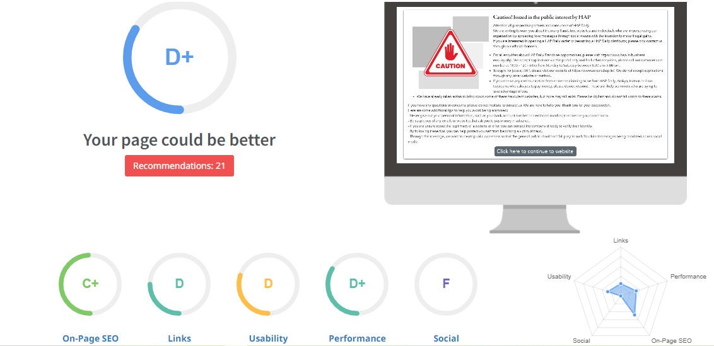
SEO Aduit
●
The website has a fair SEO score however it can be improved in certain aspects such as link building & Usability

Slide 14
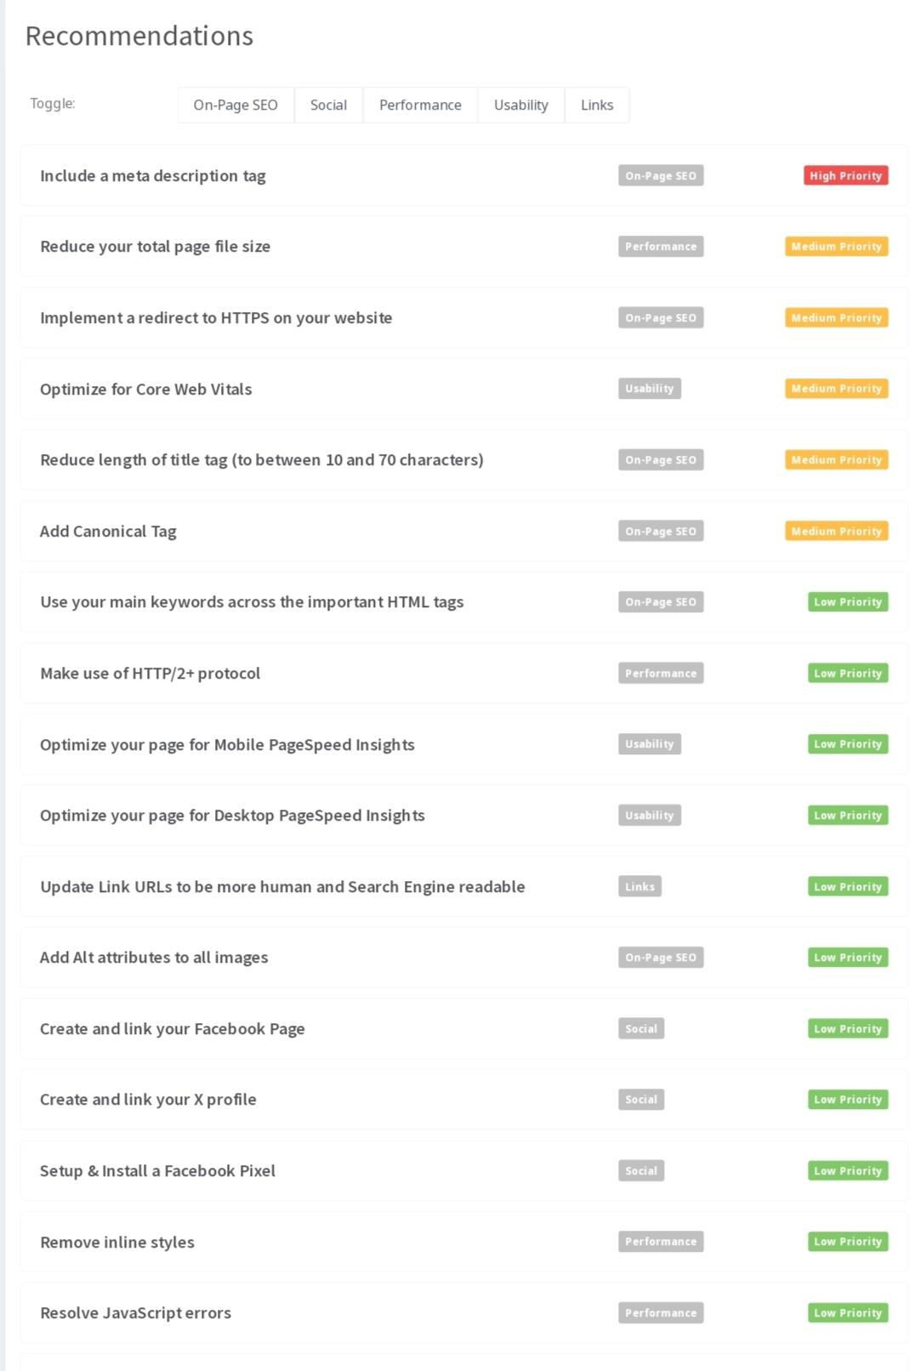
SEO Audit
Here are some points of how the website can improve its SEO
Optimise images & other assets by compressing them
  Remove duplicate H1 Tags
Start with off page activities such as link building

Slide 15
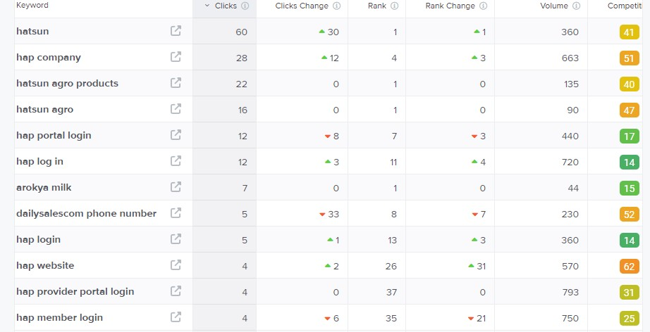
Keyword Research
Keyword objective: scale oriented
Hap company
Hatsun agro products
Arokya milk
Hap website
We can use these 4 as primary keywords since they have decent volumes and are relevant to the brands products.

Slide 16
On page Optimization
Focus Keywords : Hap company produce the hatsun agro products and Arokya milk is the product and hap website
Meta Title : Arokya milk produced by the hatsun agro products detalied in hap website
Meta Description: Hatsun agro products reach in vitamins and minerals and the product mainains the best quality

Slide 17
On page Optimization ( Content Optimization )
Introduction:
Arokya milk can be a challenge to manage , but finding the right product can make all the difference. Our guide to the best products for health offers top picks for nutirents .
Section 1: Understanding the product and explanation of arokya milk and it reach in vitmanis
Section 2 : Choosing the best product in hap company and hap website use ful for any doughts factors to consider when choosing a arokya milk products ingredients to look for an avoid
Section 3 : Top product for hap company and its packing they talking a safety and uses good products and milk is collecting from framers.
Section 4: tips for using arokya milk they keep in cold place and maintain room temperature when ever u want to use then use should boil after drink.
Conclusion:
Finding a hatsun products infused with suitable ingredants and mastering precise application methods, you’ll unlock a path to a visage

Slide 18
Document the challenges faced during the research and analysis phase , as well as the key insights gained from research process.
Getting a free to do keyword research is a task since most tools are paid.
Choosing the right keywords was an issue since there were a lot of relevant keywords in the list.
We understood how the users search & gained insights into the kind of keywords people search for.

Slide 19
Part 3: Content ideas and Marketing Strategies
Content idea Generation & Strategy : Create a content calnder for the remaining month of April brainstroming content themes, exploring various formats like blog posts, veidos, infographics, podcasts, and interactive quizzes, and scheduling publication dates mainly on Facebook & instagram. And include the strategy, aim and the idea behind only for the post and story mentioned in the calender.

Slide 20
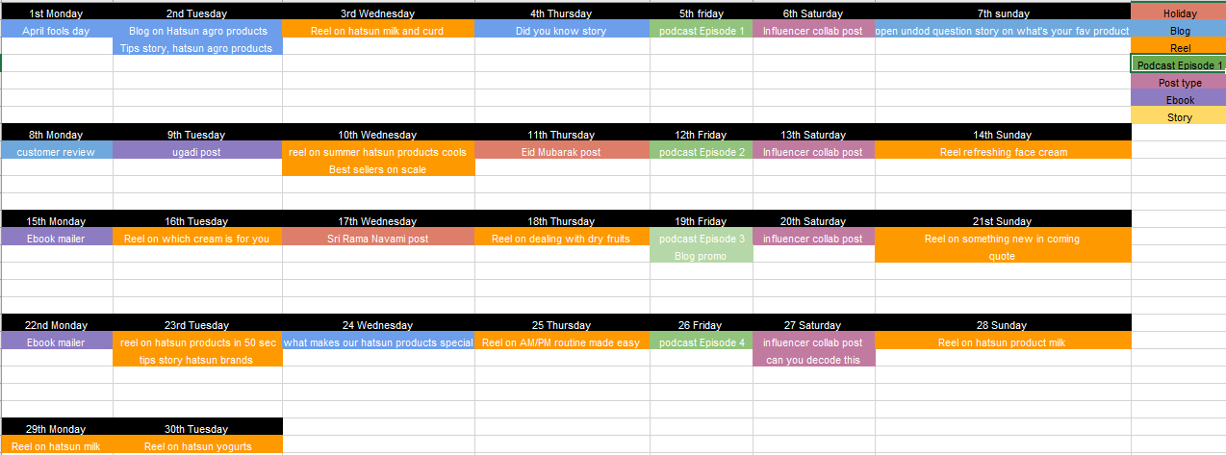
Content Calender for the month of April 2024

Slide 21
Strategy, Aim and the idea behind this story
The strategy behind this “Q&A” strategy is to educate followers about the imoprtance of hatsun agro products regardless of the weather. By addressing common misconceptions like only needing hatsun product in hap website , Hatsun agro products aims to emphasize the importance of healthy nature.
The idea is that by having these enganing stories such as the Q&A format it would engage followers and position the brand as a trusted source of hatsun agro products advice.

Slide 22
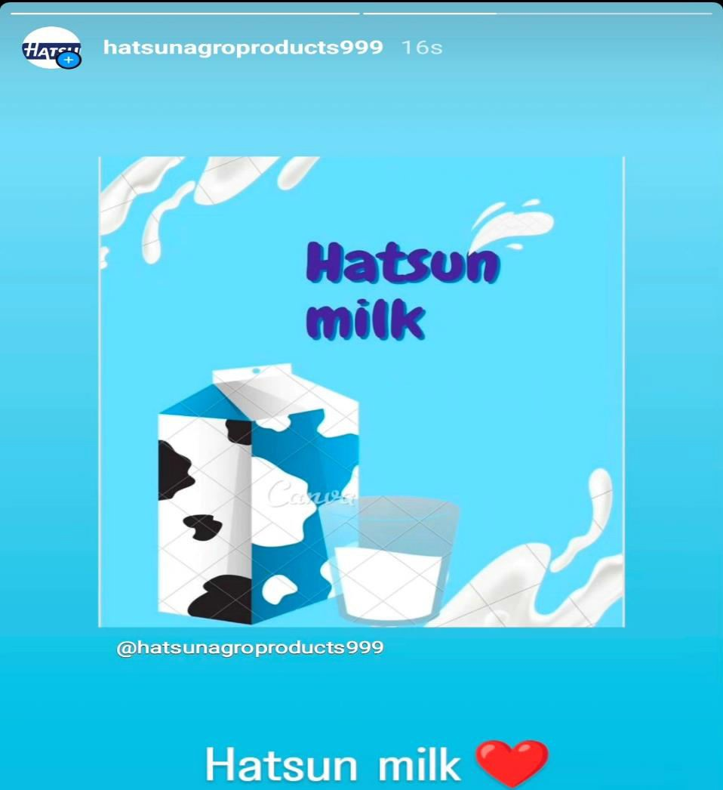
Strategy, Aim and the idea behind this story
The daily detox post would help promote Hatsun agro products yoghurt shakes are healthy because they contain no artifical flavors, colours, or preservatives,and also have micronutrients and good bacteria that can help with digestion and gut health. The shakes come in three flavours : mango, strawberry, and blueberry, and combine the flavours of fruit with the nutritional benefits of hatsun agro products.
The idea would be to use a simple creative to highlight the main USPs

Slide 23
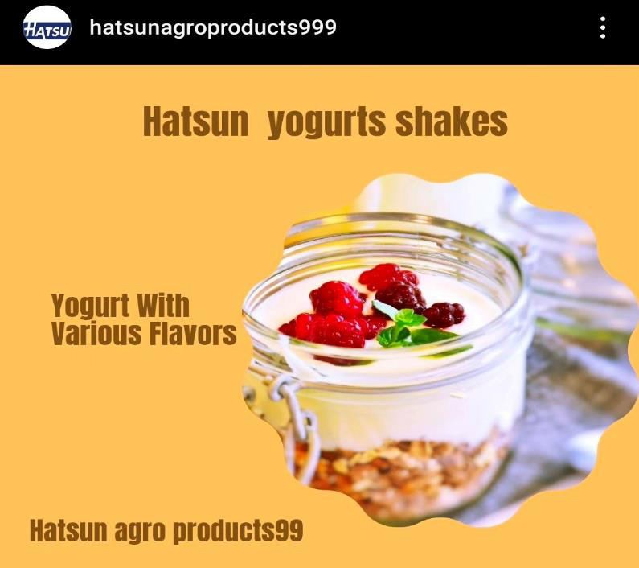

Part 3: Content
ideas and Marketing Strategies
Reflect on the content ideas amd marketing strategies process, discussing the challenges encountered and lessons leamed.

Slide 24
We as a brand wanted to understand the hatsun concerns and preferences of the auidence and creating the content to address those specific needs. Additionally, keeping the content engaging. So, by lisiting down a couple of ideas we were able to shortlist the ones shown on the content calender.
The difficult part for us was finding out what people were searching particularly for tasty and natural. By doing a search on google and looking the competitors was challenging but it helped us understand how each brand kind of had unique USPs and it helped us to look into that further and come up with posts and reel ideas accordingly while keeping the focus at being creative, engaging and informative.
PART 4:Content Creation and Curation
Post Creation:
Select Content Categories: The Hatsun agro products sourcing the finest milk from
select dairy farmers to employing state- of-the-art processing techniques, we ensure that every product meets stringent quality standards.

Slide 25
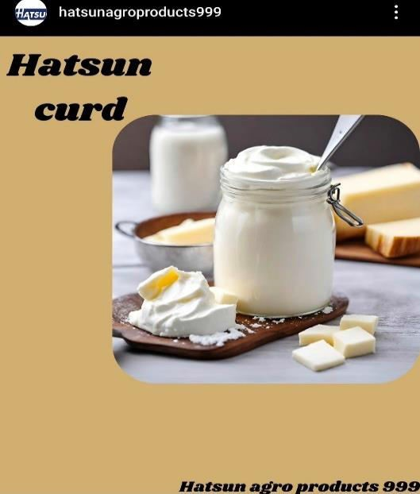
Format 1: Post
Format 2: Reel post
Format 3: Festival post
Format 1 : Static Post on Hatsun agro products
Caption: A very high-quality nutrient-rich food, milk is only produced by mammals. Here a well balanced meal is a slice in both hands.
Link: https://www.instagram.com/p/C6LN- qpKggx/?igsh=eWdnOThuM3RzbjZy

Slide 26
Post:
Hashtags: # Hatsunmilk #Milk #Hatsunproduct
Fonmat 2: Reel post on Hatsun agro Products
Caption: Hatsun curd creamy and delicious, perfect companion for afternoon meals, on hot summer days. And Hatsun cow milk undergoes pasteurisation process in which the milk is heated and product is completely safe for kids and elderly people.
Link: https://www.instagram.com/reel/C6LKnPVKa4_/?igsh=NTIxdXlleXA4aGdx

Slide 27
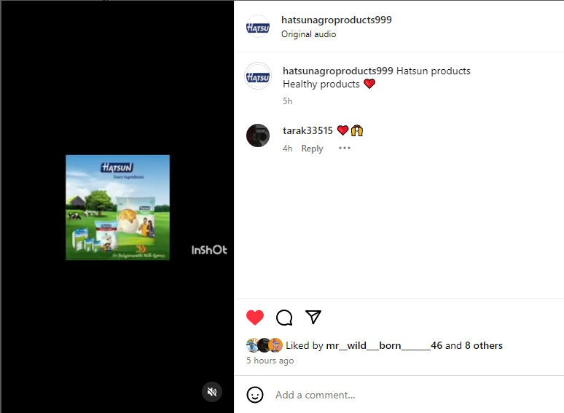
Reel post:
Hashtages:
#Hatsuncurd # curd # milk #Hatsunghee
Format 3 : Festivals post on Hatsun Yogurt
Caption: Yogurt is a healthy food much in demand and great supply. There are so many flavors and colors. Every body loves eating yogurt and hence there’s very strong competition in the market. Now your brand look the most trustworthy one has to come up with most appeling ways to market them.
Link : https://www.instagram.com/p/C6LObWQKJoh/?igsh=a3hyYWlyOHF5cTAw

Slide 28
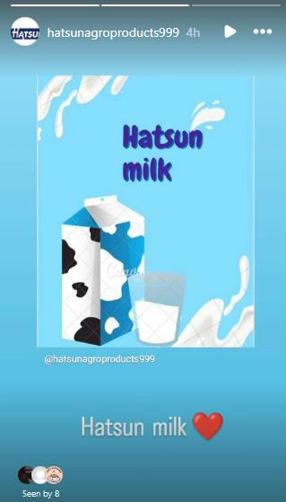
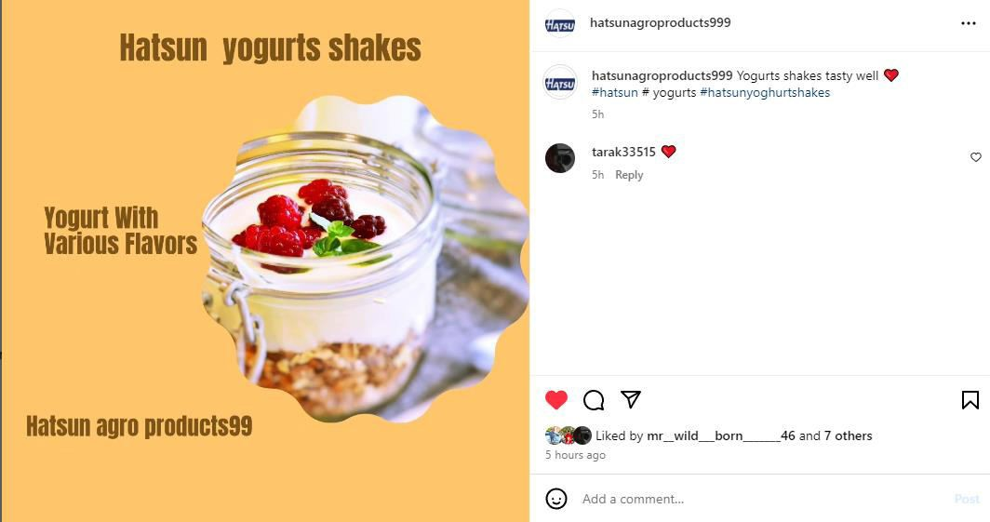
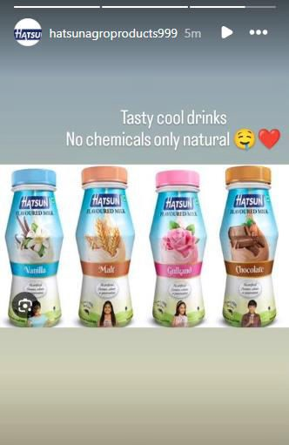
Post:
Hastags:
#yogurt #hatsunYogrut #sweetyogurt
Instagram Story
Screenshots of story.
https://www.instagram.co m/stories/hatsunagroprodu
cts999/3353862448219925117?igsh=amVsaTZtN3B3dHh2

Slide 29
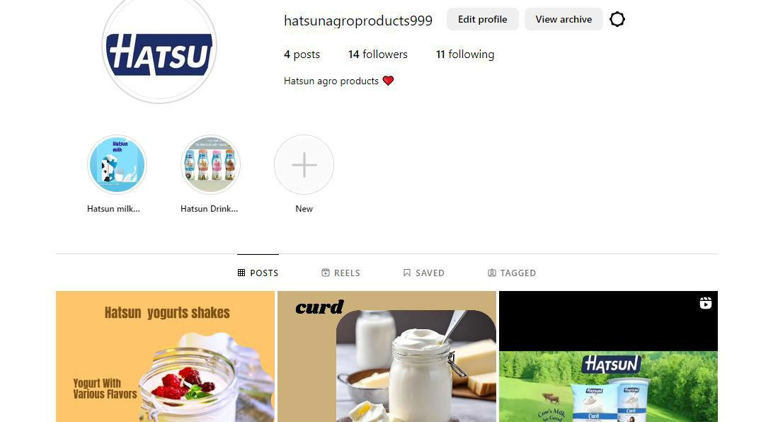
Highlights for story

Slide 30
https://www.instagram.com/stories/hatsunagroproducts999/3353862448219925117?igsh=amVsaTZtN3B3dHh2
Story Insights – Q&A
Reach is 450
Impression is 510
Like is 380
Etc……….
Area for improvement:

Slide 31
1) In the subsequent years Hatsun made milk and curd on a large scale again processing cow milk creating a wonders in the world.
2) Since the shares of hatsun agro products journey from small cooperative to global brand is a remarkable tale of innovations, social impact.
Part 4: Content Creation and Editing
Designs/Veido Editing
Design Tools Familiarization ( use canva for creating visually appearing graphics)
Video Creation : Utlize VN or any veido editer of your choice to create videos related to the chosse we inshot video app we created.

Slide 32
THANK YOU

Slide 33
Presented By
K.Chaitanya K.Tarak K.Bhaskar Rao
K. Chaitanya Kumar M.Venu Sai

